Slide 1
Planning Act 2008 process: Overview, where we are, and next steps…
Martin Almond
Operations Manager - National Infrastructure & Transport
Kay Sully
Operations Lead - National Infrastructure & Transport

Slide 2

Principles
Single consents regime
Statutory timescales
National Policy Statements
Frontloaded
Written process
Inquisitorial
Planning Act 2008 process

Slide 3


The PA2008 process
Recommendation
DEVELOPER
PINS
DEVELOPER
PINS
SofS
SofS
Decision
Pre-application
Decision
Pre-application
Examination
Acceptance
Examination
Acceptance
Pre-examination
Recommendation
Pre-examination
Recommendation
4 to 5 months
1 year +
4 to 5 months
1 year
1 year +
1 year
Planning Act 2008 process

Slide 4
Where we are now…
Pre-application stage
Planning Act 2008 process

Slide 5
Next steps…
Acceptance,
Pre-examination, and beyond
Planning Act 2008 process

Slide 6


Acceptance stage
APFP Regulations
28 days to decide
Principal tests:
NSIP
Adequacy of Consultation
Full suite of documents
Ensure all plans are correct
Satisfactory standard
Planning Act 2008 process

Slide 7

Pre-examination
Application accepted
Examining Authority appointed
Relevant Representations
Preliminary Meeting
Local authorities
Local Impact Report
SoCG
Outline of main issues/ concerns/ views related to the Proposed Development (only needs to be a summary).
Helps inform the ExA’s Initial Assessment of Principle Issues.
A deadline for submission of Written Representation will be included in the Examination Timetable.
Written Representations should expand on matters raised in Relevant Representations.
Planning Act 2008 process

Slide 8

Local Impact Reports
“…a report in writing
giving details of the likely impact of the
proposed development on the authority’s
area (or any part of that area)”.
(Section 60 PA2008)
ExA and SoS must have regard
Positive, negative and neutral impacts on local area
Joint LIR
A428 Black Cat, A66, Manston Airport
https://infrastructure.planninginspectorate.gov.uk/legislation-and-advice/advice-notes/advice-note-one-local-impact-reports/
Planning Act 2008 process

Slide 9

Examination stage
Six months
Certainty
Inquisitorial
Relevant and important
NPS(s)
Local policy context
Planning Act 2008 process

Slide 10

Recommendation and
Decision stage
The ExA has 3 months to submit its recommendation report (including recommended DCO)
The relevant SoS will then have 3 months to make its decision taking account of:
National Policy Statement(s)
Local Impact Reports
Important and relevant matters
International obligations
Judicial review (post-decision)
Planning Act 2008 process

Slide 11
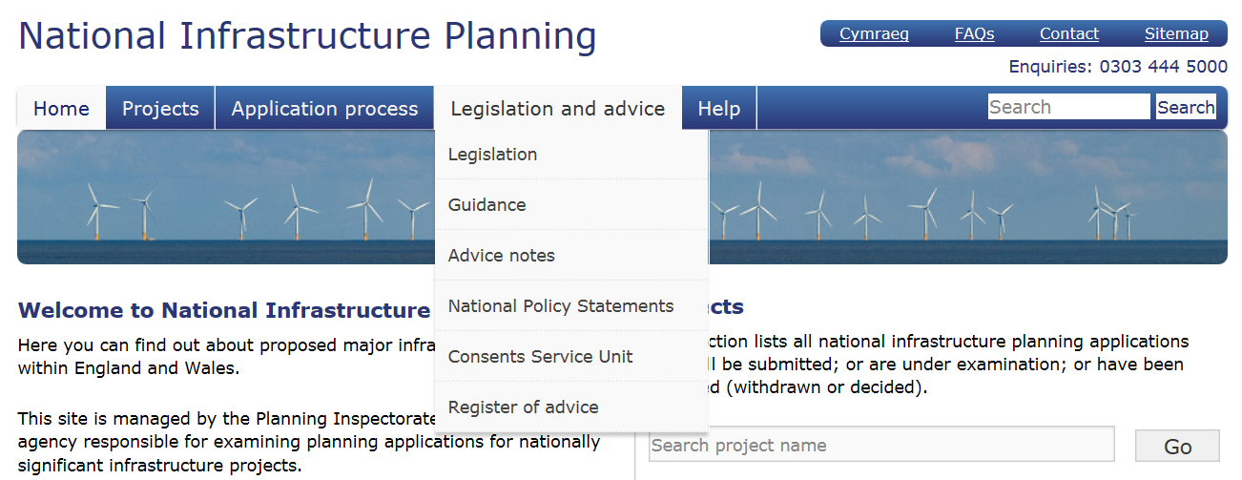
Legislation, guidance and advice
Planning Act 2008 and Regs/ Rules
DCLG Guidance (statutory)
PINS Advice Notes (non-statutory)
https://infrastructure.planninginspectorate.gov.uk/legislation-and-advice/
Planning Act 2008 process

Slide 12
Local Authorities - what next?
Check Council Scheme of Delegation
Start drafting your LIR
Look at the use of PADSS in A66 examination
Familiarisation with Advice Notes
Lastly:
Structure, requirements, legal obligation and controls of the DCO dealt with during examination.

Slide 13

Further information
Pre-application service
Pre-application service for Nationally Significant Infrastructure Projects - Prospectus for Applicants
DCLG Guidance
Planning Act 2008: examination of applications for development consent
PINS Advice Notes
Advice Note 1: Local Impact Reports
Advice Note 2: The role of local authorities in the development consent process
Advice Note 8: Overview of the nationally significant infrastructure planning process
Video on the Planning Act 2008 process
Planning Act 2008 process

Slide 14


Questions?
Contact details for the Gatwick Case Team
Email: gatwickairport@planninginspectorate.gov.uk
Tel: 0303 444 5000
Planning Act 2008 process

